Slide 1
WRP Tribal Engagement
Committee Call
July 2023

Slide 2
Today’s Agenda
Welcome and introductions
Presentations on new federal funding for energy, water and wastewater efforts (on Tribal and state allocations that Tribal can access)
Bureau of Reclamation
Kelly Titensor, PE, Native American Affairs Adviser, Office of Native American and International Affairs
FEMA
Jeremy Hollen, Public Affairs Specialist and Regional Tribal Liaison, External Affairs, Region 8
Christopher Poehlmann, Regional Tribal Liaison, National Preparedness Division, FEMA Region 9
U.S. EPA
Danny Gogal, Tribal and Indigenous Peoples Program Manager, Office of Environmental Justice and External Civil Rights
Pat Childers, Tribal Program Manager, Office of Air and Radiation
Next steps and actions
Around the Phone Updates

Slide 3
WRP Tribal Engagement Committee Co-Chairs
LeRoy Shingoitewa (Hopi)
Elveda Martinez, Walker River Paiute Tribe and Native American Fish and Wildlife Society (NAFWS) President, Southwest Regional Director
Will Micklin, CEO, Ewiiaapaayp Band of Kumeyaay Indians
Floyd W Velasquez Sr., Emergency Services Administrator, Morongo Band of Mission Indians

Slide 4
Kelly Titensor Native American Affairs Adviser Office of Native American and International Affairs, U. S. Bureau of Reclamation
Indian Health Service (IHS) Sanitation Facilities Construction (SFC) Program (1980-2007)
Included planning, designing, and constructing water supply and wastewater systems serving Indian communities.
Consulted and advised IHS management and Indian Tribes on environmental and water resource (domestic and sanitary) engineering issues.
Bureau of Reclamation in the Montana Area Office as a Native American Affairs Coordinator (2007-2011)
Worked with six of the seven Montana Tribes on water resource issues such as rural water system construction projects, dam rehabilitation and improvements, water rights settlements, stream rehabilitation, basin studies, and assisting Tribes with a variety of water resource projects through the Native American Affairs Technical Assistance program.
Washington Office, Native American and International Affairs Office, as a policy adviser (2011-present). Works on a variety of issues including legislative initiatives, the Native American Technical Assistance program, consulting and advising on Self-Determination/Self-Governance issues, Indian climate change and energy/water nexus issues, and water rights settlement negotiation and implementation activities.
Registered civil engineer in California.

Slide 5
Bureau of Reclamation Funding Opportunities for Tribes
Western Regional Partnership
Tribal Engagement Committee
July 28, 2023

Slide 6
Program Areas
Native American Affairs Technical Assistance Program
WaterSMART
Small Storage Program
Inflation Reduction Act
Solar Over Canals
Emergency Drought Relief for Tribes
Domestic Water Supply Projects

Slide 7
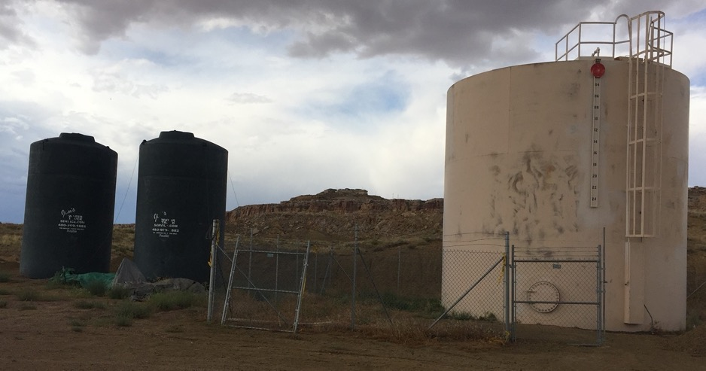
Native American Affairs Technical Assistance Program
Provide technical assistance to assist Indian Tribes in developing, managing, and protecting their water and related resources https://www.usbr.gov/native/programs/TAPprogram.html
7
Notes:
Problem: In late November 2018, Reclamation learned that a portion of the Hopi Tribe’s domestic water supply infrastructure had failed and that no water was being delivered to 110 homes. The water tank was inoperable due to broken piping and valves.
Temporary Solution: In early December, the Lower Colorado River Basin’s Phoenix Area Office funded a 60-day rental of a 15,500 gal HDPE tank from a potable water tank supplier through the Field Services Conservation program as temporary emergency storage.
Permanent Solution: Reclamation funded (~$28K) the permanent repairs to the tank and Navajo Engineering and Construction Authority completed the repairs in March 2020. The existing tank is now operational.

Slide 8
Native American Affairs Technical Assistance Program
43 USC 373d: Increase opportunities for Tribes to develop, manage, and protect their water and related resources.
Funding limited by total funds available. Typically, $400k-$500k/award.
Project duration: 2 years
Past projects:
Protection of water resources
Water quality assessments
Water needs/supply assessments
Well development
Repairs/rehabilitation to existing infrastructure
8
8
Notes:
Construction limitations - $200,000
Feasibility studies
Equipment only purchases
No biological studies
Threshold criteria
Examples of eligible projects
Water needs assessments
Water management studies
Water quality data collection and assessments
Water measurement studies
Training for tribal staff and managers in areas of water resources development, management and protection
Minor rehabilitation or replacement of existing tribally-owned, water-related structures and facilities
Restoring wetlands
Controlling erosion
Stabilizing stream banks
Federally-recognized tribe or tribal organization located in one of the 17 western states
Proposal must further the development, management and/or protection of water and water-related resources
Proposal must be for one or two year duration, with maximum funding of $100,000 per year.
Examples of Ineligible Projects
Projects that lack definable products or deliverables
Specific employment positions within an Indian tribe
Projects related to water rights negotiations/litigation
Projects related to non-federal or non-tribal dams and associated structures
Purchase of equipment as the sole purpose of the project
Projects in direct support of litigation of any kind
Projects that will obligate Reclamation to provide perpetual funding.
Biological activities

Slide 9
Native American Affairs Technical Assistance Program
Proposals submitted through Notice of Funding Opportunity Announcement (https://www.grants.gov/)
Awards competitive: FY23 funding ~ $4.5M
Funding mechanisms: Grants/Cooperative Agreements, PL 93-638, Direct Funding for BOR staff, Interagency Agreements
Occasional additional requests for projects – keep running list of unmet needs
Anticipate 2024 funding level will be? (appropriations).
9
9

Slide 10
Technical Assistance to Tribes
Threshold criteria:
Federally-recognized tribe or tribal organization located in one of the 17 western states
Proposal must further the development, management and/or protection of Tribal water and water-related resources
Proposal should be for two-year duration
Maximum funding per award depending on total funding available.
10

Slide 11
Technical Assistance to Tribes
Examples of eligible projects
Water needs assessments
Water planning and management studies
Water quality data collection and assessments
Water measurement studies
Training for tribal staff and managers in areas of water resources development, management and protection
Minor rehabilitation or replacement of existing tribally-owned, water-related structures and facilities
Preliminary Engineering Reports
Restoring wetlands
Controlling erosion
Stabilizing stream banks
11

Slide 12
Technical Assistance to Tribes
Examples of Ineligible Projects
Projects that lack definable products or deliverables
Specific employment positions within an Indian tribe
Projects related to water rights negotiations/litigation
Projects related to non-federal or non-tribal dams and associated structures
Purchase of equipment as the sole purpose of the project
Projects in direct support of litigation of any kind
Projects that will obligate Reclamation to provide perpetual funding.
Biological activities
Contact Regional Native American Program manager for assistance
Review website at: https://www.usbr.gov/native/programs/techasst_activities_tap.html
12

Slide 13
Jeff Morris, Program Manager
Native American and International Affairs Office
Commissioner’s Office
Denver, Colorado
303-408-4997
jmorris@usbr.gov
www.usbr.gov
https://www.usbr.gov/native/index.html

Slide 14
WaterSMART
Bureau of Reclamation
Water Resources and Planning Office

Slide 15
WaterSMART Program Grants Building a Foundation
On-the-Ground Projects
Drought Contingency Plans
Cooperative Watershed Management Program
Water Marketing Strategy Grants
Water Conservation Field Services Program
Basin Studies
Aquatic Ecosystems Restoration Projects
Water Recycling and Desalination Planning
Applied Science Tools
Drought Resiliency Projects
Basin Studies
Drought Resiliency Projects
Water and Energy Efficiency Grants
Small-Scale Water Efficiency Projects
Environmental Water Resources Projects
Title XVI
Large Scale Water Recycling
Water Desalination
Aquatic Ecosystems Restoration Projects
Science and Tools
Planning
Notes:
(Rebekah slide)
Take-away: There is a lot going on in WaterSMART. Contact us if you have a project to see if we have a program that fits.
This diagram shows generally how these projects all fit together.
Reservoir Operations Pilots: Reclamation initiative using modeling and forecasting tools to identify ways to increase flexibility in reservoir operations to support optimal water management.

Slide 16
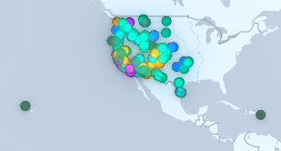
Bipartisan Infrastructure Law Funding for WaterSMART
WaterSMART Programs Receiving Infrastructure Funding
Program Area | Funding Amount (Over Five Years) | Activities Funded
WaterSMART Grants | $400 million | Water conservation and efficiency, renewable energy, natural and nature-based features, drought, water scarcity
Title XVI Water Reclamation and Reuse Program | $550 million | Water Recycling
Cooperative Watershed Management Program | $100 million | Watershed planning and restoration projects for watershed groups
Aquatic Ecosystems Restoration and Protection Projects | $250 million | Aquatic ecosystem restoration and protection projects to improve habitat
Multi-Benefit Projects to Improve Watershed Health | $100 million | Restoration projects to improve watershed health
BIL Funded Projects to Date
208 Projects
$553.8M in BIL Funds
$1.9B in total Project Costs
Notes:
WaterSMART received generous allocations of BIL funding that covers most of the funding opportunities you saw on the previous slide. In total, WaterSMART received $1.4 billion to implement our various programs. To date, we have selected 208 BIL funded projects utilizing $553.8 million of the funds made available. In addition, we have proposed that a portion of the $550 M made available under IRA for the planning, design, and construction of domestic water supply systems be allocated through WaterSMART grants, in particular the planning and design grants and drought resiliency projects which has been expanded to include project that address water scarcity in general). This is currently in the approval process and we are hopeful that this approach is found acceptable.

Slide 17
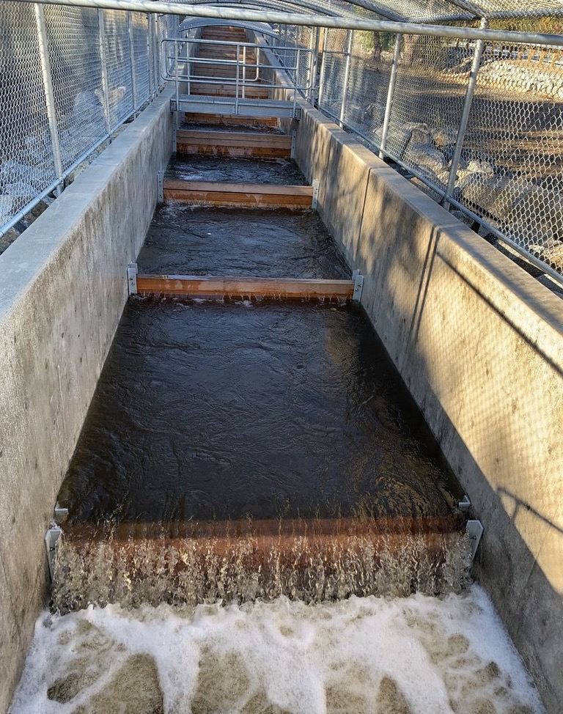
Aquatic Ecosystem Restoration Projects
Eligible Project Types
Funds the study, design, and construction of large-scale aquatic ecosystem restoration and protection projects
Projects should improve habitat or fish passage, including through the removal or bypass of fish barriers
Prioritizes projects that provide regional benefits (across multiple basins), are a component of an aging infrastructure strategy, or benefit an underserved community
Two Phases
Planning and Design
Construction
Currently open on grants.gov. Applications due January 24, 2023.
Notes:
A Reclamation team is currently developing program criteria and example project types.
We expect to provide an opportunity for public comment on the criteria this fall, with a funding opportunity by the end of the year.
Removal or modification of a dam requires owner consent or no written objection form entities that collectively receive 1/3 or more of the water or power from the facility
Public comment will be considered prior to initiating a project

Slide 18
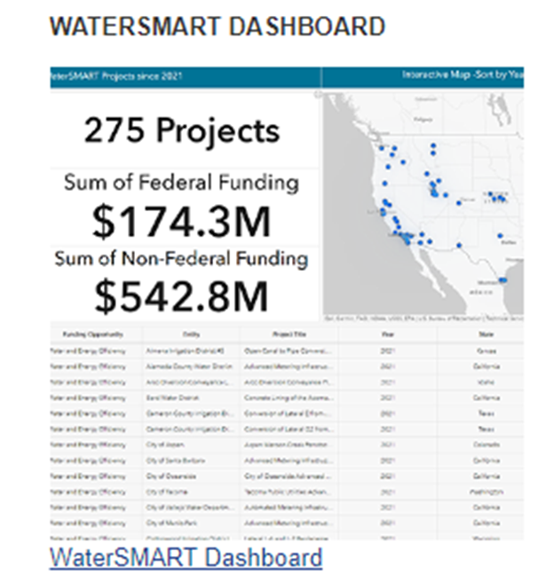
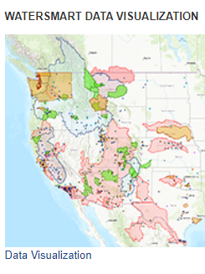
WaterSMART Program Resources
WaterSMART Program Website: https://www.usbr.gov/watersmart
Previously funded applications for all programs
Interactive Data Visualization Tool
WaterSMART Dashboard
Funding opportunity calendar
WaterSMART mailing list
Recent announcements
Notes:
Data visualization site is an interactive tool including:
Interactive maps
Featured project tours
Program growth over time

Slide 19
Questions?
Coming Soon to Grants.gov!
Drought Resiliency Projects
Cooperative Watershed Management Planning and Project Design
Title XVI
Sheri Looper
916-978-5556
slooper@usbr.gov
Drew Manning
303-445-2730
amanning@usbr.gov

Slide 20
Small Storage Program
Bureau of Reclamation
Policy & Programs Office

Slide 21
Small Storage Program
Small storage projects are defined by:
Water storage capacity of not less than 200 acre-feet and not more than 30,000 acre-feet and:
increases surface or groundwater storage; or
conveys water, directly or indirectly, to or from surface water or groundwater storage
Eligible Non-Federal project sponsors:
will include a state, regional, or local authority; Indian tribe or tribal organization; or other entities such as a water district or water association within the 17 Western States, Alaska, or Hawaii.
Funding:
Awards are limited to the lesser of $30 million or 25% of project costs.
Funding will be allocated through a competitive process.

Slide 22
How to Become Eligible for Small Storage Project Funding
A completed feasibility study must be submitted and found to meet all requirements of Reclamation’s Directives and Standards.
Directive & Standard | Reference
Small Surface Water and Groundwater Storage Projects Feasibility Study Review Process (CMP TRMR-127) | https://www.usbr.gov/recman/temporary_releases/cmptrmr-127.pdf
Review Process Flow Chart (CMP TRMR-127 Appendix A) | https://www.usbr.gov/recman/temporary_releases/cmptrmr-127-AppA.pdf

Slide 23
Next Steps & Resources
Submission of Small Storage Feasibility Studies
Approved feasibility studies are required in order to apply for future funding opportunities.
Reclamation accepts studies at any time, however the review process can take up to 180 days.
Notice of Funding Opportunity
The Fiscal Year 2024 NOFO is currently under development.
Anticipated release Summer/Fall 2023, with awards in 2024.
Small Storage Program Website: https://www.usbr.gov/smallstorage/
Program Coordinator:
Austin Olah, aolah@usbr.gov or (303) 445-3240; OR
Small Storage Mailbox, bor-sha-smallstorage@usbr.gov
Notes:
Small Storage Program Website includes link to subscribe for more information

Slide 24
Solar Over Canals IRA Section 50232
Western Regional Partnership’s Tribal Engagement July 28, 2023

Slide 25
Background
Section 50232 “Canal Improvement Projects” of the Inflation Reduction Act (IRA).
$25 million for the design, study, and implementation of solar panel projects over Reclamation canals.
Few projects of this scope exist in the world.
Reclamation to construct pilot project(s) to better understand impacts to its facilities, scale of the efforts, and potential benefits.

Slide 26
Eligibility - Applicants
Canals associated with a Reclamation project that are operated and maintained by a Transferred Works Operator.
Canal facilities associated with an authorized Reclamation project.

Slide 27
Eligibility - Projects
Projects that study, demonstrate, apply, and construct photovoltaic (PV) solar panels over Reclamation canals.
Selected project will be used as a pilot or demonstration for Reclamation.
Project shall include the physical planning, design, and construction of the solar panel technology over the Reclamation canal.

Slide 28
Selection Process
Proposal submission through Reclamation Regional Directors.
Initial Screening.
Application Review Committee – Technical Sufficiency Evaluation.
Management Review.

Slide 29
Contact Information Reclamation Asset Management Division (AMD)
Darion Mayhorn – Operations & Maintenance (O&M) Branch Supervisor
DMayhorn@usbr.gov
O: 303-445-3121 C: 720-275-8827
Mike Studiner – Civil Engineer, AMD O&M Branch
MStudiner@usbr.gov
O: 720-415-2794

Slide 30
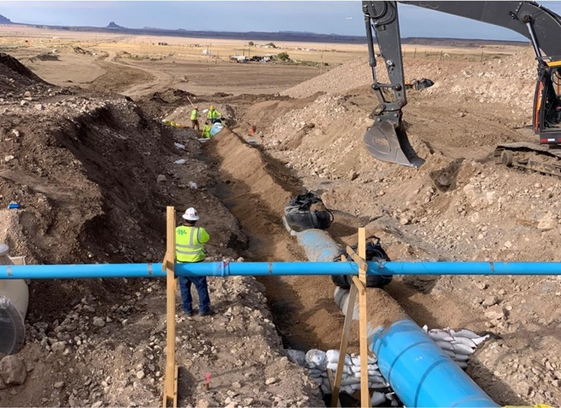
Inflation Reduction Act Sec. 80004. Emergency Drought Relief for Tribes​
$12.5 million available through September 30, 2026 for near-term drought relief actions to mitigate drought impacts for Indian Tribes that are impacted by the operation of a Bureau of Reclamation water project, including through direct financial assistance to address drinking water shortages and to mitigate the loss of Tribal trust resources.”​

Slide 31
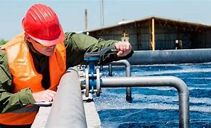
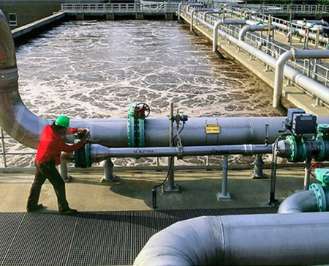
Inflation Reduction Act Sec. 50231. Domestic Water Supply Projects
$550 million available through September 30, 2031 for up to 100 percent of the cost of the planning, design, or construction of water projects to provide domestic water supplies to communities or households that do not have reliable access to domestic water supplies." ​
Reclamation is setting aside $5.5 for U.S. Territories for projects that will provide domestic water supplies to communities or households that do not have reliable access to potable water.

Slide 32
Please stay tuned for funding opportunities under sections 80004 and 50231 of the Inflation Reduction Act. Projects specifically for disadvantaged communities for planning, design, or construction of water projects to provide domestic water supplies to communities or households that do not have reliable access to domestic water supplies will be considered under section 50231. Federally recognized Tribes or Tribal Organizations, as defined by 25 U.S.C. 5304(e), in the 17 western states including: Washington, Oregon, Idaho, Montana, North Dakota, South Dakota, Nebraska, Wyoming, California, Nevada, Utah, Colorado, Kansas, Oklahoma, Texas, New Mexico, and Arizona are being considered as disadvantaged communities and are eligible for consideration.

Slide 33
Reclamation is currently formatting plans for this funding based on stakeholder input and Tribal consultation.
For more information about Reclamation's implementation of IRA, please visit:
www.usbr.gov/inflation-reduction-act/
You may contact us at USBR.IR.Act@usbr.gov if you have any questions.

Slide 34
Jeremy Hollen Public Affairs Specialist | Regional Tribal Liaison, External Affairs Region 8 FEMA
Supports federal emergency management functions among tribal nations located within the states of Colorado, Montana, Utah, and Wyoming.

Slide 35
Christopher Poehlmann Regional Tribal Liaison, Preparedness and Analysis Branch National Preparedness Division, FEMA Region 9
Began with FEMA in 2009, as a Disaster Assistance Employee (DAE) in the mitigation cadre. First deployed as a Tribal Planner, working with Tribes in Southern California. After several other deployments across the country, deployed to Nevada as the Mitigation Task Force leader to assist Tribes in the state write or update their mitigation plans. At this time, worked with the Navajo Nation to update their mitigation plan, which had expired.
In 2017, became one of region 9’s two Tribal Liaisons in the National Preparedness Division. Continued to work on the Navajo Nation’s mitigation plan, which was completed and approved in 2018.
Currently focuses on the training needs of the Tribal communities in California but works closely with the Tribal team to offer any needed assistance to the region.
Works in partnership with the state of California and other federal agencies who support Tribal Nations.
Worked extensively on the COVID-19 response for Tribes in the region and was awarded a Superior Contribution Award for his work from HHS.

Slide 36
FEMA Funding Opportunities
Jeremy Hollen and Christopher Poehlmann | July 2023
Notes:
(Title Slide Option 1)

Slide 37
Agenda
Introduction to FEMA Regions 8 and 9
Funding through Federal Disaster Declarations
DHS/FEMA Mitigation & Preparedness Grants
Tribal Training Opportunities

Slide 38
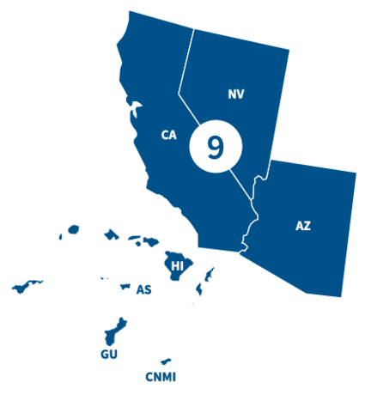
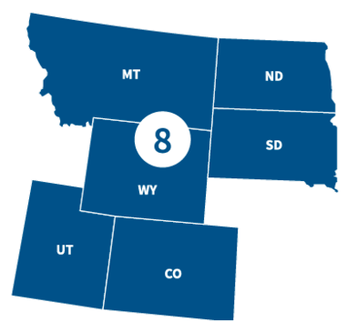
FEMA Regions 8 and 9
Notes:
Region 8
Colorado
Montana
North Dakota
South Dakota
Utah Wyoming
29 Federally recognized tribal nations
Region 9
Arizona
California
Hawaii
Nevada
Guam
American Samoa
Commonwealth of Northern Mariana Islands
Republic of Marshall Islands
Federated States of Micronesia
150 federally recognized Tribal Nation

Slide 39
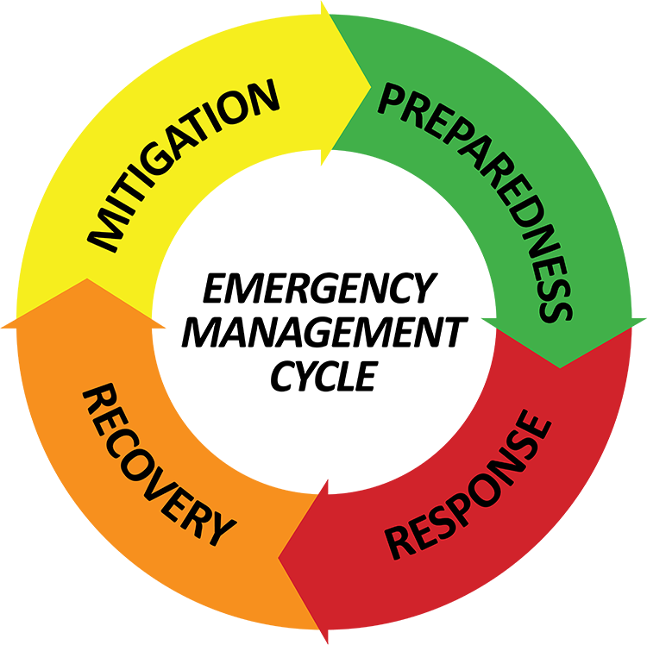
FEMA’s Mission: Helping people
during and after disasters
before,

Slide 40
FEMA’s Mission: Helping people
during and after disasters
before,
Notes:
Also mention STORM Act

Slide 41
FEMA’s Mission: Helping people
during and after disasters
before,
Hazard Mitigation Assistance Grants
FEMA's hazard mitigation assistance provides funding for eligible mitigation measures that reduce disaster losses.
"Hazard mitigation" is any sustainable action that reduces or eliminates long-term risk to people and property from future disasters.

Slide 42
FEMA’s Mission: Helping people
during and after disasters
before,
Building Resilient Infrastructure and Communities (BRIC)
FEMA’s BRIC grant is a competitive annual grant program supports governments as they implement hazard mitigation projects to reduce the risks from disasters and natural hazards.
Direct technical assistance:
Hazard Mitigation Plan Development/Update
Mitigation of a Specific Hazard(s) or In-Depth Risk Assessment of a Specific Hazard(s)
Project Identification, Conceptualization, and Scoping
Budget Development and Potential Funding Sources Identification
Community Outreach and Partnership Development
Grant Writing and Management Workshops
Notes:
The BRIC program aims to shift the federal focus away from reactive disaster spending and toward proactive investment in community resilience. FEMA funds BRIC with a 6% set-aside from federal post- disaster grant funds, such as Public Assistance and Individual Assistance grants. As a competitive grant program, applicants can apply on a yearly basis.
BRIC DTA gives full, hands-on support to selected communities for a wide range of need types to enhance each community’s capacity to concretely pursue hazard mitigation. Some Tribal communities have taken advantage of this opportunity and have had great success in moving forward with Mitigation Plans and Projects to help their communities be more resilient in disasters.

Slide 43
FEMA’s Mission: Helping people
during and after disasters
before,
DHS Preparedness Grants
The FY 2023 DHS preparedness grant programs provide more than $2 billion in funding to state, local, tribal and territorial governments, as well as transportation authorities, nonprofit organizations, and other eligible entities as outlined in the funding notices.
These grant programs are intended to improve the nation’s readiness in preparing for, responding to and recovering from terrorist attacks, major disasters, and other emergencies.
The total amount for each grant program is set by Congress and the allocations are made by the Department of Homeland Security and FEMA.

Slide 44
FEMA’s Mission: Helping people
during and after disasters
before,
Tribal Homeland Security Grant
In FY 2023, THSGP provided $15 million to directly eligible tribes to help strengthen the nation against risks associated with potential terrorist attacks.
The intent of the THSGP is to award funding to assist eligible tribes in obtaining the resources required to support the National Preparedness Goal’s associated mission areas and core capabilities as they apply to tribal lands.
Eligibility requirements
Located on or near (100 miles) an international border or a coastline bordering an ocean (including the Gulf of Mexico) or international waters
Located within 10 miles of a system or asset included on the DHS prioritized critical infrastructure list
Located within or contiguous to one of the 50 most populous metropolitan statistical areas in the United States
Jurisdiction of which includes not less than 1,000 square miles of Indian country
Notes:
This Year 43 applications were received , 40 applications were deemed eligible, and 19 applications are awarded FY 2023 THSGP funding.

Slide 45
FEMA’s Mission: Helping people
during and after disasters
before,
Homeland Security Grant Program
&
Emergency Management Performance Grant
Provides funds for building and sustaining national preparedness capabilities. A state Administrative
Agency (SAA) is the only entity eligible to submit HSGP applications.

Slide 46
Emergency Management Institute Tribal Curriculum
E0580 Emergency Management Framework for Tribal Governments
Course Purpose: To assist tribal communities to understand emergency management principles and develop and implement comprehensive emergency management systems.
E0581 Emergency Operations for Tribal Governments
Course Purpose: To assist tribal officials to develop organizational structures, operational procedures, and resources for effective emergency operations.
Tribal Training Week
E0582 Mitigation for Tribal Governments
Course Purpose: To give tribal governments a foundation for reducing or preventing potential losses from natural or other hazards.
L0583 Emergency Management Overview for Tribal Leaders
Course Purpose: To give tribal leaders an understanding of emergency management principles and practices in order to protect tribal citizens, lands, and culture. .
L0552 Continuity of Operations (COOP) for Tribal Governments
In final development

Slide 47
Contact Slide Option 2
Contact
Jeremy Hollen
Region 8 Tribal Liaison
Jeremy.hollen@fema.dhs.gov
Christopher Poehlmann
Region 9 Tribal Liaison
Christopher.Poehlmann@fema.dhs.gov

Slide 48
Danny Gogal Acting Division Director, Program Development and Learning Division Office of Environmental Justice and External Civil Rights (OEJECR) U.S. Environmental Protection Agency
Has a public policy, environmental policy, and public administration background.
Worked in EPA’s Environmental Justice Program since its inception in June 1992.
Continues to serve as the Tribal and Indigenous Peoples Program Manager for OEJECR and has been working on tribal and indigenous peoples’ environmental policy and environmental justice issues for over 35 years.
Also serves as EPA’s lead for international human rights agreements and advancing environmental justice internationally. Works directly in communities providing technical support for community revitalization and development.

Slide 49
Environmental Justice and External Civil Rights (EJECR) Technical & Financial Resources,
U.S. EPA
Presentation to Western Regional Partnerships - Tribal Engagement Committee
July 28, 2023

Slide 50
Topics
Federal and EPA Policies Advancing EJ
Executive Order 14096 - Revitalizing Our Nation's Commitment to Environmental Justice for All
EPA EJ Financial and Technical Assistance Program
Thriving Communities Technical Assistance Centers (TCTACs)
Environmental Justice Thriving Communities Grantmaking (TCGM) Program - TCGM Subawards
EJ Change Cooperative Agreements

Slide 51
Executive Order 14096 – Reviving Commitment to EJ for All
EO 14096 Issued April 21, 2023, and builds upon EO 12898 (issued in 1994)
Updates language & concepts
Recognition of role of civil rights law
Enhances accountability - Create performance metrics and other means of accountability
Need for an All-of-Government Approach – expanded federal agencies involved
Establishes a definition for “Environmental Justice”
- “…the just treatment and meaningful involvement…”

Slide 52
EO 14096 (Continued)
Identify, analyze, and address disproportionate and adverse human health and environmental effects (including risks), including those related to climate change and cumulative impacts
Evaluate relevant authorities and consider adopting mitigation
Identify analyze and address historical and systemic barriers
Tribal consultation
National Environmental Policy Act (NEPA)
Ensure Title VI compliance
Create performance metrics and other means of accountability
Dedicate staff, funding and other resources
Provide training for agency staff

Slide 53
EO Definition for Environmental Justice
Environmental justice means the just treatment and meaningful involvement of all people, regardless of income, race, color, national origin, Tribal affiliation, or disability, in agency decision-making and other Federal activities that affect human health and the environment so that people: (i) are fully protected from disproportionate and adverse human health and environmental effects (including risks) and hazards, including those related to climate change, the cumulative impacts of environmental and other burdens, and the legacy of racism or other structural or systemic barriers; and (ii) have equitable access to a healthy, sustainable, and resilient environment in which to live, play, work, learn, grow, worship, and engage in cultural and subsistence practices.” [Underlines added for emphasis]

Slide 54
Inflation Reduction Act (IRA) Environmental and Climate Justice Grants – August 2022
IRA, Sec. 60201 – Environmental and Climate Block Grants
The Clean Air Act was amended to add: ‘‘SEC. 138. ENVIRONMENTAL AND CLIMATE JUSTICE BLOCK GRANTS.‘‘
Award grants for periods of up to 3 years to eligible entities to carry out activities
$2,800,000,000 to available until September 30, 2026, to award grants for the eligible activities to the eligible entities

Slide 55
Eligible Activities for EJ IRA Funding
ELIGIBLE ACTIVITIES — An eligible entity may use a grant awarded under this subsection for:
Community-led air and other pollution monitoring, prevention, and remediation, and investments in low- and zero emission and resilient technologies and related infrastructure and workforce development that help reduce greenhouse gas emissions and other air pollutants;
Mitigating climate and health risks from urban heat islands, extreme heat, wood heater emissions, and wildfire events;
Climate resiliency and adaptation;
Reducing indoor toxics and indoor air pollution; or
Facilitating engagement of disadvantaged communities in State and Federal public processes, including facilitating such engagement in advisory groups, workshops, and rulemakings.
Notes:
Heat pumps are example of “investments in low- and zero emission and resilient technologies” and weatherizing homes would be an example of “related infrastructure” to reduce GHG emission and other pollutants
The installation of heat pumps, given their ability to both heat and cool a home can help mitigate climate and health risks from urban heat islands, extreme heat, wood heater emissions, and wildfire events. Right now as we have speak we have heat waves going on and wildfire smoke impacting disadvantaged communities and households that do have heat pumps can cool their homes and close their windows to reduce heat and wood smoke exposure.
As our summer’s get hotter installation of electric heat pumps with their ability to cool can be a tool or action that could be taken to help with Climate resiliency and adaptation
As indicated above installing HPs could improve indoor AQ in homes from summer wildfire smoke and during the winter time for those houses currently heating with wood by using a heat pump this could reduce their exposure to potentially harmful wood stove emissions.

Slide 56
Eligible Entities to Receive IRA EJ Grants
ELIGIBLE ENTITIES
a partnership between -
an Indian tribe, a local government, or an institution of higher education; and
a community-based nonprofit organization;
a community-based nonprofit organization;
or a partnership of community-based nonprofit organizations.

Slide 57
Definition for Community-Based Non-Profits (CBOs)
Community-Based Non-Profits – [definition used for the EJ CPS and EJ G2G programs, which will likely be used or be similar for future grant programs] “community-based nonprofit organization” (CBO) is a public or private nonprofit organization that supports and/or represents a community and/or certain populations within a community through engagement, education, and other related services provided to individual community residents and community stakeholders. A “community” can be characterized by a particular geographic area and/or by the relationships among members with similar interests and can be characterized as part of a broader national or regional community where organizations can be focused on the needs of urban, rural, and/or tribal areas, farmworkers, displaced workers, children with high levels of lead, people with asthma, subsistence fishers, and other similar groups.

Slide 58
Office of Environmental Justice and External Civil Rights (OEJECR) Financial Technical & Financial Assistance Programs

Slide 59
EJ Thriving Communities Technical Assistance Centers (TCTACs)
17 selected TCTACs will help advance EJ through technical assistance, training, and capacity-building
TCTACs will work with: underserved communities, Pacific Islands organizations, federally recognized tribes, state recognized tribes, tribal/indigenous grassroots organizations, etc.
The TCTACs will be operated by colleges/universities; large nonprofits; or intertribal consortia.
Expected to be operational by the end of the summer of 2023

Slide 60
TCTACs (Continued)
Examples of Technical Assistance Services Provided:
Grant writing to strengthen applications for environmental and energy justice (EEJ) related funding
Managing federal grants (e.g., accounting, policies, controls)
Identifying funding sources to apply for (federal, local, private)
Navigating government grant systems such as SAM.gov and Grants.gov
Developing partnerships and coalitions addressing EJ issues
Community engagement, meeting facilitation, and translation and interpretation services for limited English-speaking participants
Notes:
3rd bullet- Larry shared with me that the Burn Wise Program is in communication with OEJECR TCTAC leads to provide TCTACs information about electric heat pump technology’s, their multiple benefits and IRA funding options.

Slide 61
TCTACs (Continued)
Region 1 - University of Connecticut
Region 2 - West Harlem Environmental Action, Inc. & Inter-American University of Puerto Rico-Metro Campus
Region 3 - National Wildlife Federation
Region 4 - Research Triangle Institute
Region 5 - Blacks in Green & University of Minnesota Goal
Region 4 & 6 - Deep South Center for EJ
Region 6 - New Mexico State University
Region 7 - Wichita State University
Region 9 - University of Arizona & San Diego State University
Region 10 - Willamette Partnership & University of Washington
Three National TCTACs - Institute for Sustainable Communities, National Indian Health Board & International City/County Management Association

Slide 62
Environmental Justice Thriving Communities Grantmaking Program (EJ TCGM)
Environmental Justice Thriving Communities Grantmaking Program
- $550 million total funding
Funding: Approximately $50 million per award ($16.5 per year, for 3 years) - Applications: Were due June 30, 2023
Eligibility: Federally Recognized Tribal government, or institution of higher education (e.g. Tribal Colleges and Universities) in partnership with a Community-Based Non-Profit (CBO), or a partnership of CBOs.
New, innovative program to fund up to 11 entities to serve as Grantmakers, using efficient, simplified processes for organizations historically challenged to receive funding for community-based projects to reduce pollution through subawards.
Webinar Assistance Call – provided March 16, 2023 - View Zoom recording (Passcode: 38640870) & EJ TCGM Overview Webinar Slides (pdf)

Slide 63
Environmental Justice Thriving Communities Grantmaking Program (Continued)
Subawards - Environmental Justice Thriving Communities Grantmaking Program (TCGM)
- a new, innovative program to fund Grantmakers, who are to create and use efficient, simplified processes for organizations historically challenged to apply for and receive funding - as subawards
The subawards under the Grantmaker program will be available for three distinct phases:
Phase I = Assessment projects for up to $150,000 for a one-year project period
Phase II = Planning projects for up to $250,000 for a one/two-year project period, and
Phase III = Project Development projects for up to $350,000 for a two-year project period
Notes:
Danny, during one of these phases could a community based organization, perhaps in partnership with a tribe or local government hire a staff person to be a liaison/case worker to help people to and navigate how to tap into DOE’s $8.8B Home Energy Rebate/direct discount Program so people could take advantage of the $12K for installing heat pumps.?

Slide 64
Environmental Justice Change Cooperative Agreements
Funding: Approximately $2 Billion total for the program, with grant award amounts likely to be about $10 to $20 million each
Notice of Funding Opportunity (NOFO)/Request for Applications (RFA) expected to be issued by late-summer 2023
Eligibility: 1) community-based non-profit organizations (CBOs); 2) federally recognized tribes, local governments, or institutions of higher education in partnership with a CBO; and (3) CBO partnerships.
EPA is considering the input received through a Request for Information, which ended April 10, 2023, and other sources of input, to create the NOFO/RFA.
August 3 – Webinar for input on NOFO from tribes and indigenous peoples
August 9 – Webinar for input from indigenous communities in American Samoa, Guam and NMI.

Slide 65
Questions?
Contact Information:
Danny Gogal, Gogal.danny@epa.gov
Acting Division Director, Program Development and Learning Division
- Tribal and Indigenous Peoples Program Manager
Office of Environmental Justice and External Civil Rights, U.S. EPA

Slide 66
Pat Childers Senior Tribal Program Manager Office of Air and Radiation (OAR) U.S. Environmental Protection Agency
40 years working with EPA’s partners in reducing air pollution, including the past 10 years working directly with Tribes.
Designated Federal Official for the Clean Air Act Advisory Committee and the Clean Air Excellence Awards Program for 9 years. Increasing tribal participation in both programs was a priority.
Previously at EPA, spent twenty years at OAR’s Office of Transportation and Air Quality (OTAQ) as Deputy Chief of staff and numerous other implementation and enforcement functions varying from tribal and state coordination to program enforcement. A majority of time at OTAQ was coordinating with State, Local and Tribal officials on mobile source regulatory and voluntary measures.
Looks forward to focusing his remaining years at EPA on Tribal air programs and advancing healthier environments in Indian country.

Slide 67
OAR update on Inflation Reduction Act Funding – WRP Tribal Engagement Call
July 28th, 2023

Slide 68
Questions to consider asking
The “W”s – what, when, where, why, who????
What part of IRA is this?
When is the program going to be announced? Applications Due?
Where can I find out more about the program?
Why are these provisions here (congressionally mandated?)
Who is my contact ? In the Region and at OAR?

Slide 69
Resources and Tools - New and Existing
Existing
Regional and OAR Tribal Air Coordinators
NTAA Regional Representative
ITEP/TAMS
Fellow Tribes
WRP
Me childers.pat@epa.gov
New
Thriving Communities Technical Assistance Centers (TCTAC)
Environmental Professionals Network (EPN)
Program Specific resources and Tools (CPRG)

Slide 70
Inflation Reduction Act Resources on Federal Funding
White House Open Funding Opportunities- Inflation Reduction Act
Open Funding Opportunities | Clean Energy | The White House
White House Inflation Reduction Act Guidebook in Indian Country
https://www.whitehouse.gov/wp-content/uploads/2023/04/Inflation-Reduction-Act-Tribal-Guidebook.pdf
EPA IRA and BIL
https://www.epa.gov/inflation-reduction-act/epa-funding-announcements-bipartisan-infrastructure-law-and-inflation
Identifying and Applying for Grants
Grants.gov: clearinghouse for all federal grant opportunities, includes training and resources
EPA Grants Office: training and resources on applying for grants: www.epa.gov/grants

Slide 71
Office of air Inflation reduction act Programs (1/2)
Program | Funding ($) | Opening Date | Closing Date
Clean Air Act Grants (Sec. 60105(f)) | $25 M non-competitive grants | February 15, 2023 | Competition closed April 17; applications are currently under review.
CPRG Planning Grants | $250 M non-competitive grants | March 1, 2023 | Opt-in period closed 3/31 for states, 4/28 for MSAs; tribe / territory workplans due 6/15. Funds to be awarded June-August 2023 for states/metro areas, likely August-September 2023 for Tribes/Territories.
CPRG Implementation Grants | $4.6 B competitive grants | Later in 2023 | Applications likely due in the first quarter of calendar year 2024.
Funding to Address Air Pollution at Schools | $37.5 M competitive grants | Fall 2023 | TBD
https://www.epa.gov/invest/epa-funding-announcements-bipartisan-infrastructure-law-and-inflation-reduction-act

Slide 72
Office of air Inflation reduction act programs (2/2)
IRA Provisions | Use of Funds | Funding
Grants to Reduce Air Pollution at Ports | Competitive grants and rebates to reduce air pollution at ports. | $3B
Clean Heavy-Duty Vehicles | Grants, rebates, and contract support to help cover costs of replacing dirty heavy-duty vehicles with clean zero emission vehicles. | $1B
Funding to Address Air Pollution | Grants and other activities to support air monitoring and screening. | $205.5M
Diesel Emissions Reductions | Funding for Diesel Emissions Reduction Act program. | $60M
Funding for Section 211(o) | Funding to support investments in advanced biofuels and to implement the Renewable Fuel Standard. | $15M
Mobile Source Grants | Grants for States to adopt and implement zero-emission standards. | $5M
Implementation of the AIM¹ Act | Grants to assist with meeting hydrofluorocarbon reduction commitments. | $38.5M
1. American Innovation and Manufacturing
Note: Table does not include Low Emissions Electricity Program, GHG Corporate Reporting
Notes:
How much detail per program?
All the programs?

Slide 73
Funding fair
Objectives
Demystify the federal funding landscape for CPRG stakeholders
Continued general interagency collaboration long-term
Provide guidance on opportunities for leveraging complementary incentives
Structure
Sector-based sessions: Transportation, Power, Buildings, Industrial, and Agriculture
What information is most helpful to states, local, and tribal governments?

Slide 74
Action Items/ Next Steps

Slide 75
Action Items
Seeking your input please:
Recommendations for Tribal leader(s) to co-chair the WRP Natural Resources Committee
Please sign up for a WRP account – wrpinfo.org
Invite/Encourage other Tribal members/liaisons to be part of TETWG
Please provide input on Tribal Leadership excel document
Please indicate if you:
Interested in being part of the TEC Outreach Subcommittee
Have recommendations on future agenda topics
Additional resources like a study/funding for the good of the team
Interested in being part of a WRP Deep-Dive (2023/2024 Deep-Dives in support of WRP Priority Enhancing Resilience to Avoid Cascading Disaster:
Water Security/resilience
Wildland Fire (response/ prevention)
Aviation/ Airspace Needs

Slide 76
Confirm Next call and Action Items
August 25 | Overview of DHS Tribal Homeland Security Advisory Council (THSAC) by Floyd W Velasquez Sr., Emergency Services Administrator, Morongo Band of Mission Indians – and THSAC member
September 29
October 27 | USGS Tribal engagement on drought in the Colorado River Basin: Recent and ongoing activities of the ASIST (Actionable and Strategic Integrated Science and Technology) Initiative by Jeanne Godaire, Regional Senior Scientist and Jessica Driscoll, Ph.D. Science Program Officer – both with the U.S. Geological Survey, Rocky Mountain Region, Interior Region 7: Upper Colorado Basin
December 1
Note: Calls are held from 10 am to 11:30 am Pacific

Slide 77
Around the Phone Updates

Slide 78
Biden-Harris Administration Announces Nearly $1 Billion in New Internet for All Funding Available to Tribal Lands Info provided by Robert Tse
This is the announcement of Round Two of the Tribal Broadband Connectivity Program. $980 Million is available.
NTIA expects to make awards in this round of funding within the following ranges:
Broadband Internet infrastructure deployment projects proposed by a single applicant: $1 million to $50 million
Broadband Internet adoption and use projects: $100,000 to $2.5 million
An Eligible Entity may use grant funds made available under the TBCP for:
broadband infrastructure deployment, including support for the establishment of carrier-neutral submarine cable landing stations;
affordable broadband programs, including— (i) providing free or reduced-cost broadband service; and (ii) preventing disconnection of existing broadband service;
distance learning;
telehealth;
digital inclusion efforts (which may include digital equity planning and workforce development activities); and
broadband adoption activities.
Applications are due at 11:59 p.m. Eastern Time (ET) on January 23, 2024.

Slide 79
The SNS is OPEN!
Complete the survey by September 29, 2023 to influence the future of emergency communications!
cisa.gov/sns | SNS@cisa.dhs.gov
Notes:
SLIDE

Slide 80
Western Regional Partnership
Wrpinfo.org

