Slide 1
Tribal Engagement Committee
March 28, 2025

Slide 2
Today’s Agenda
Welcome and Introductions
Featured Presentation:
  The Critical Minerals Mapping Across the United States Under the USGS Earth Mapping Resources Initiative (Earth MRI) by Jamey Jones
Next Steps and Actions
Around the Phone Updates

Slide 3


Science Coordinator, USGS Earth Mapping Resources Initiative
  Joined USGS in 2011
  Based in Anchorage, Alaska
Conducts field-based research on the bedrock geology and mineral resources of Alaska, the Great Lakes region, and the western U.S.
Previously: Taught at universities in Minnesota and Arkansas
Ph.D. in Geology, University of Texas at Austin. M.S. in Geology, University of Wyoming. B.S. in Geology, University of the South.
Jamey Jones
Science Coordinator
USGS Earth Mapping Resources Initiative
USGS

Slide 4
CRITICAL MINERALS MAPPING ACROSS THE UNITED STATES UNDER THE USGS EARTH MAPPING RESOURCES INITIATIVE (EARTH MRI)
Jamey Jones, Earth MRI Science Coordinator
USGS photo of silica carbide

Slide 5
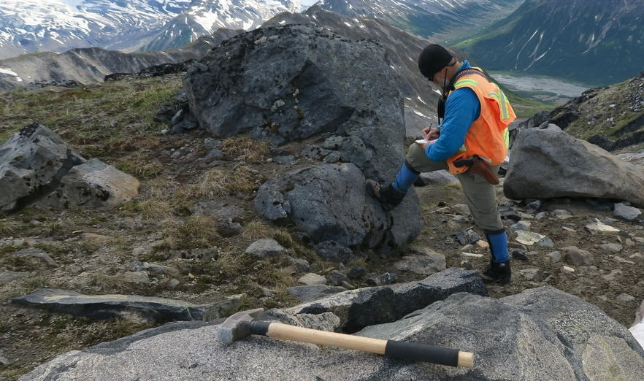
The USGS provides unbiased science to support decision-making
The USGS Energy and Mineral Resources Mission Area leads research and assessment of natural resources in the U.S.
Energy Resources Program
Mineral Resources Program
Organic Act of 1879
“examine the geological structure, mineral resources, and products within and outside the national domain”
Occurrence and distribution of resources
Supply, demand, extraction, use, and disposal
Effects of resource use; wastes as a resource

Slide 6
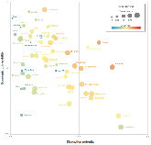
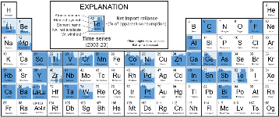

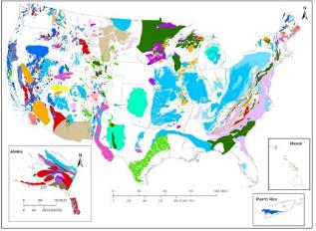

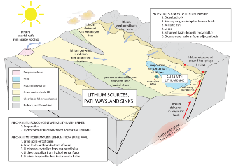

USGS provides unbiased science to support decision-making
The USGS provides unbiased science to support decision-making
The USGS Mineral Resources Program conducts research and assessment of the geologic framework and mineral resources of the U.S.
Mineral Information and Intelligence
Analyze present-day and future supply, demand, and global trade for mineral commodities and evaluate mineral criticality
Earth Mapping Resources Initiative
Domestic data acquisition, mapping, and synthesis to characterize mineral resources still in the ground and above ground in mine wastes
Research and Assessments
Understand mineral systems and deposits, as well as the impacts of development, and conduct mineral resource assessments
Supply chain analysis and list of critical minerals
Mapping the Nation’s geologic framework and mineral resource potential
Decision support to land managers and policy makers
6

Slide 7
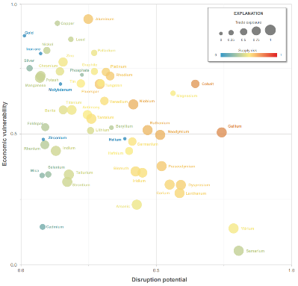
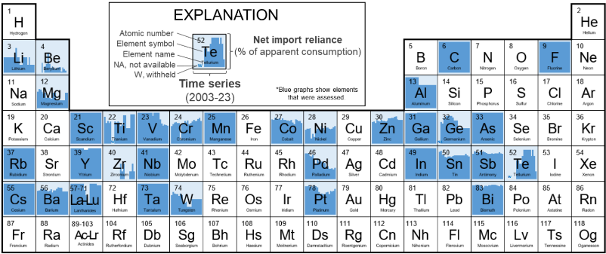
The U.S. has a current focus on “critical” mineral resources
The U.S. has focused on critical mineral resources since 2018
Critical mineral resources are those that are essential to the U.S. economy and national security, have a supply chain that is vulnerable to disruption, and serve an essential function in the manufacturing or a product
Revised list individually lists the rare-earth elements and platinum-group elements by specific element forms; added Ni and Zn; removed He, potash, Re, Sr, and U
Initiated by Presidential Executive Order 13817 (2018)
Critical minerals defined by the Energy Act of 2020
USGS published the first list of 35 critical minerals in 2019 and a revised list in 2021 that contains 50 individual mineral commodities
Nassar and Fortier, 2021, USGS OFR 2021-1045

Slide 8
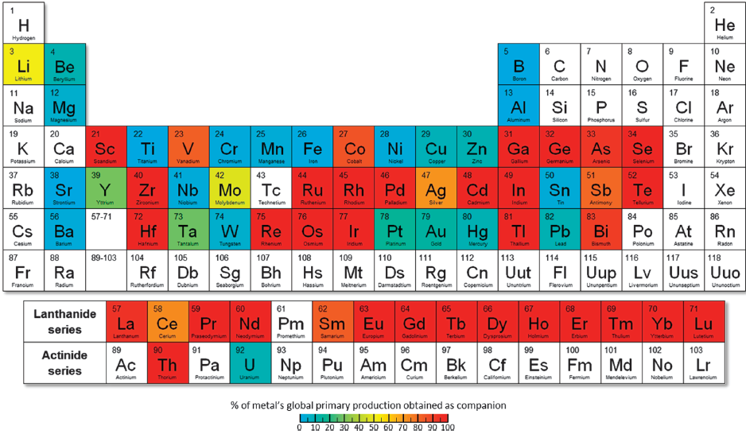
The U.S. has a current focus on “critical” mineral resources
The U.S. has focused on critical mineral resources since 2018
Critical mineral resources are those that are essential to the U.S. economy and national security, have a supply chain that is vulnerable to disruption, and serve an essential function in the manufacturing or a product
Many, if not most, critical mineral commodities occur as coproducts or byproducts of other associated commodities
Example → tellurium for photovoltaic films is produced as byproduct of copper processing
gallium for semiconductors is produced through mining and processing aluminum or zinc
Initiated by Presidential Executive Order 13817 (2018)
Critical minerals defined by the Energy Act of 2020
USGS published the first list of 35 critical minerals in 2019 and a revised list in 2021 that contains 50 individual mineral commodities
Nassar et al., 2015, Industrial Ecology

Slide 9
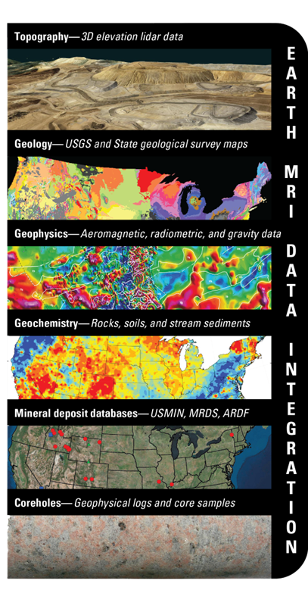
Earth Mapping Resources Initiative
Goal: Modernize mapping of the United States through framework geoscience data, presently focused on identifying areas that may have the potential to contain critical mineral resources
$10.8M Annual appropriation (beginning FY19)
$64M Bipartisan Infrastructure Law (FY22-26)
$74.8M Total for FY24
$5M 2023 Disaster Relief Supplemental for industrial minerals in Florida and Puerto Rico
Applications:
Mineral resources
Energy resources
Natural hazards
Water resources
Land use planning
Infrastructure
Partners:
State geological surveys
Federal agencies (e.g., DARPA, DOE, NASA, BLM, USFS, NPS)
Tribes
Industry
NGOs

Slide 10
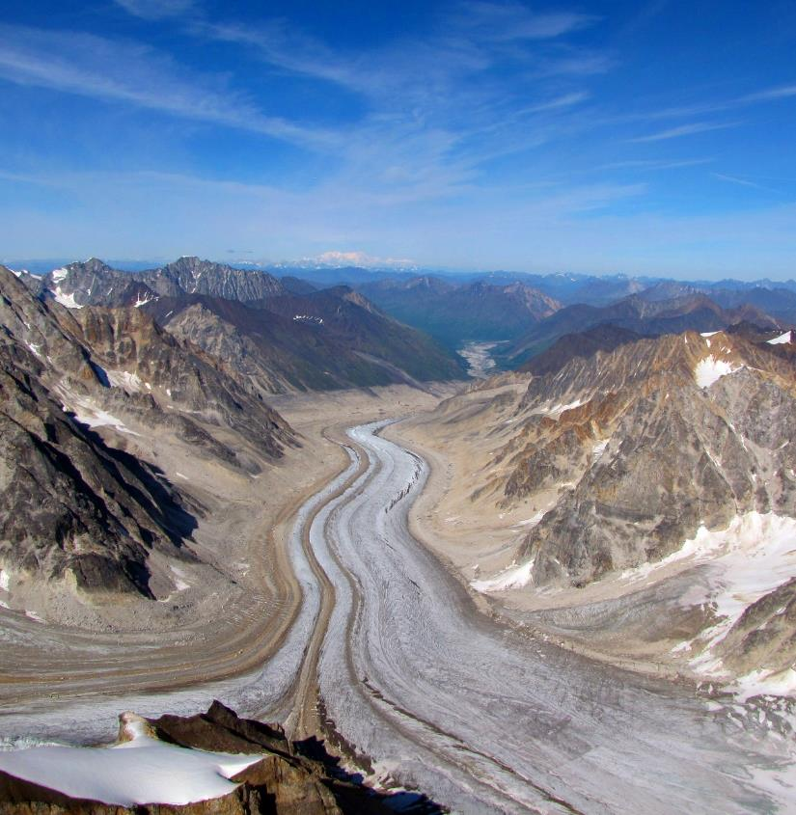
Earth MRI Data and Interpretations
Collecting fundamental geoscience data including:
  High-resolution elevation (lidar) surveys (3DEP)
  Airborne geophysical surveys (magnetic, radiometric, electromagnetic)
  Detailed geologic mapping and regional geochemical mapping by State surveys
  Remote sensing/hyperspectral surveys
  Mine waste inventory and characterization with State partners
  Preservation of minerals data and geochemistry of archived materials (NGGDPP)
  Other large data needs?
https://www.usgs.gov/special-topics/earth-mri

Slide 11
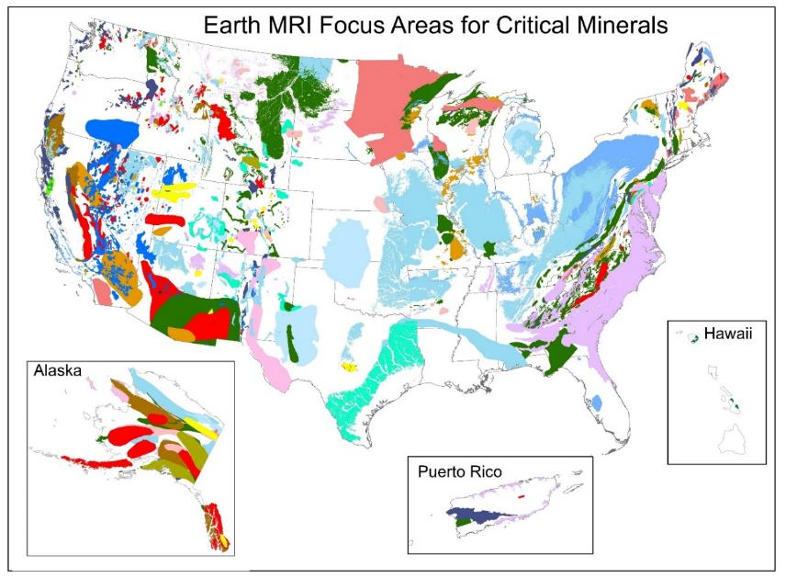
Mineral systems help focus and prioritize data collection
Mineral systems encompass the geo-tectonic framework in which ore deposits form
They are based on mappable criteria that can facilitate mineral resource assessments
They include all possible critical element associations whether as primary, secondary, etc.
Conceptual framework provides flexibility for mapping new critical minerals and minerals-dependent technologies
Dicken and others, 2022, GIS, supplemental data table, and references for focus areas of potential domestic resources of critical minerals and related commodities in the United States and Puerto Rico:
U.S. Geological Survey data release, https://doi.org/10.5066/P9DIZ9N8.

Slide 12
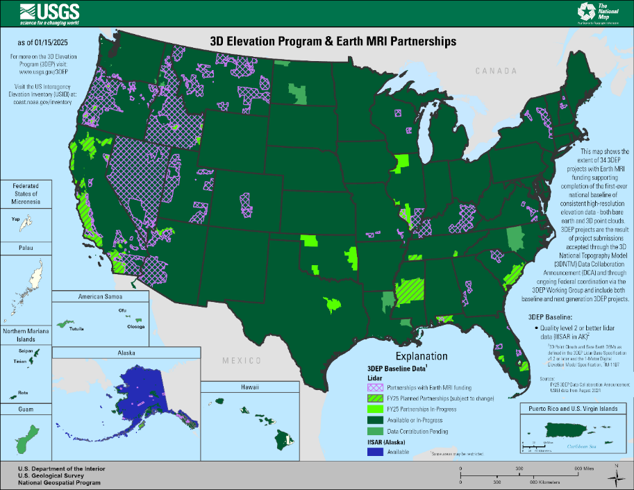
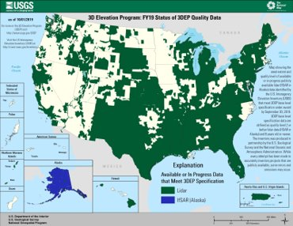
Lidar acquisition nearing completion for conterminous U.S.
Earth MRI partners with National Geospatial Program/3DEP to acquire new lidar to aid geologic mapping
Additional funding leveraged through partnerships
New lidar acquisition in progress for Alaska to support mine waste mapping and measurement
FY2019 ​Pre-Earth MRI​
www.usgs.gov/3DEP

Slide 13
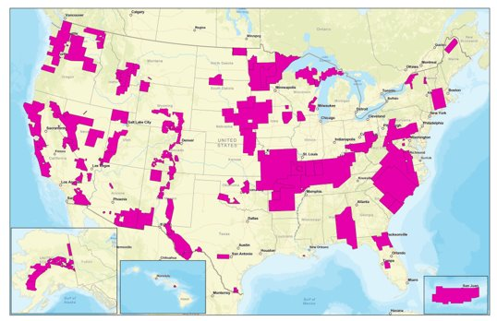
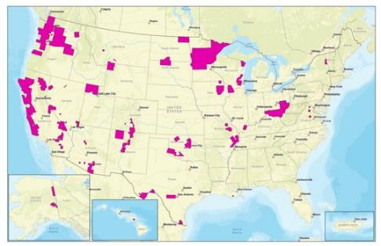
Geophysical data provide foundation for regional mapping and modeling
Airborne magnetic, radiometric, and electromagnetic surveys are designed to meet core data needs and state priorities
FY19-22 mag-rad surveys cover an area the size of Texas (~268k sq mi)
FY23 and 24 mag-rad surveys cover nearly 300k sq mi (2x Montana)!
Current high-quality coverage planned, in progress, and/or completed (through FY24)
FY2019 ​Pre-Earth MRI​

Slide 14
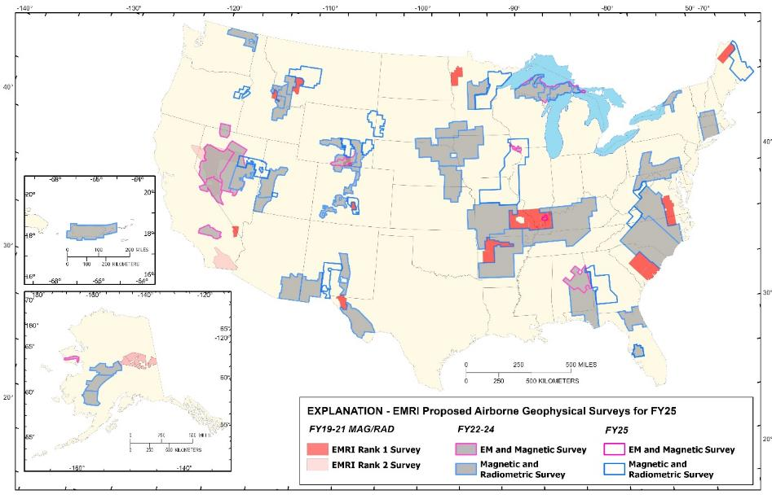
Geophysical data provide foundation for regional mapping and modeling
Airborne magnetic, radiometric, and electromagnetic surveys are designed to meet core data needs and state priorities
BIL funding has allowed for multi-year efforts that will result in seamless, high-quality regional coverage
Surveys consider both below- and above-ground resources (i.e., mine waste)
Ideally, state projects including geologic mapping, geochemical reconnaissance, and/or mine waste are linked with survey planning and design
Current Earth MRI Airborne Geophysics (2025) planned, in progress, and/or completed

Slide 15
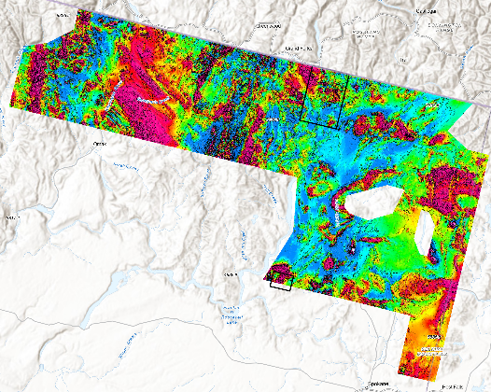
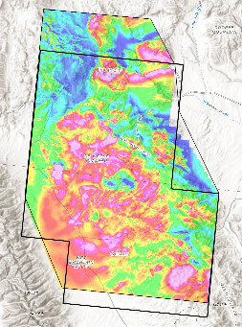
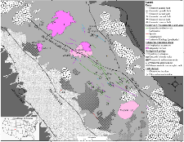
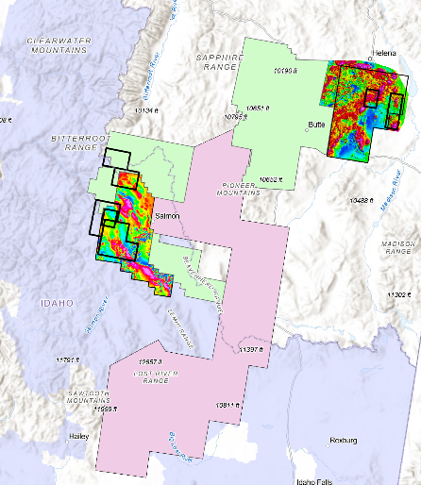
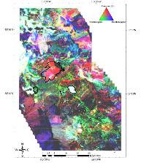
Geophysical and mapping data are ideally integrated at multiple scales
WA Republic survey
USGS and States line up mapping and other studies with airborne geophysical surveys to enhance/optimize workflow and outcomes
Orient 15’ quad – funded in FY23
Cedar Canyon mining district – funded in FY21
Confluence of lidar, airborne mag-rad, geologic and geochemical mapping, and mine waste studies in Montana and Idaho
Wet Mountains (CO) mapping – funded in FY20
Magnin et al., 2023, Tectonics

Slide 16
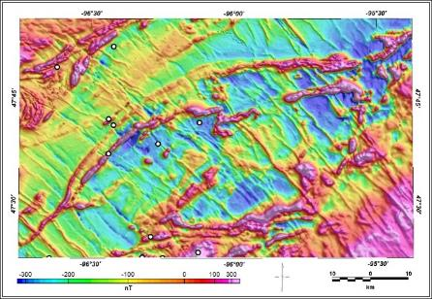
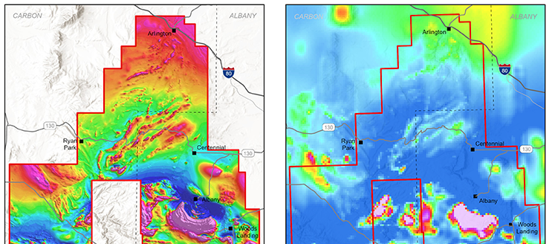
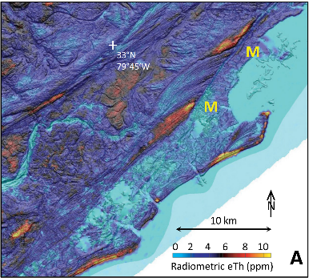

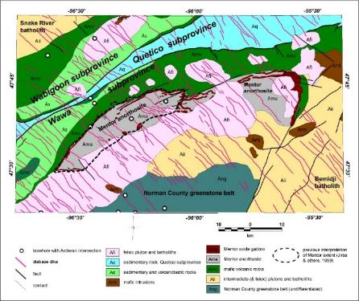
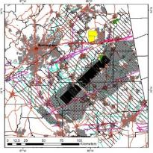
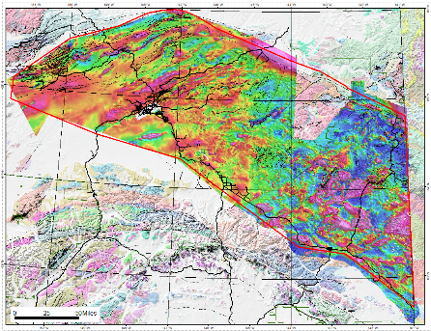

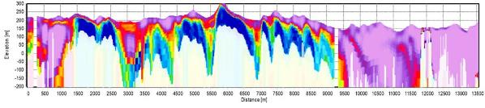
Data quality improves geophysical and geologic interpretations
Anji Shah and the South Carolina
Geological Survey, GSA Today
Ben Drenth and MN Geological Survey
Ben Drenth and Wyoming Geological Survey (above)
Patricia MacQueen, Paul Bedrosian, and Alabama Geological Survey (below)
Jacob Murchek, Ben Drenth, and Alaska DGGS

Slide 17
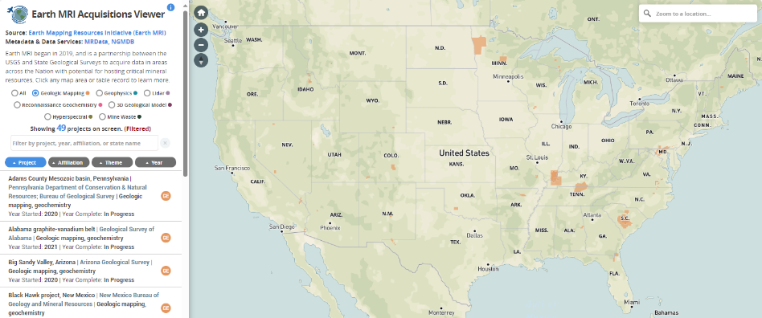
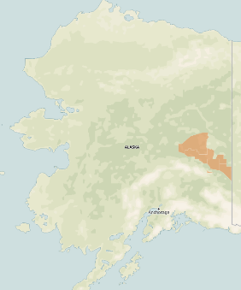
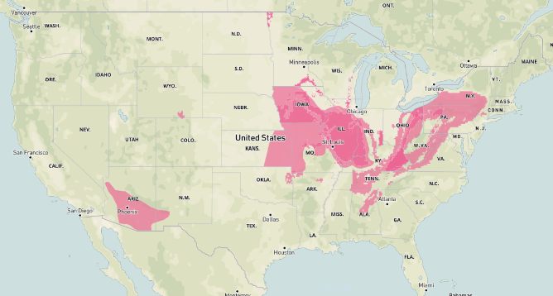
Geologic mapping is ongoing by many State surveys
In FY24 EMRI funded 22 mapping projects involving 25 State surveys​
15 geologic mapping projects​
7 geochemical mapping projects​
Estimated FY24 mapping allocation exceeded ~$8M to States (~75% BIL funded), with additional funding for geochemistry support​
To date, EMRI has funded 86 geologic mapping projects and 21 geochemical mapping projects in 39 different states
Mapping in Florida and Puerto Rico mapping is supported by FY23 Disaster Supplemental funds

Slide 18

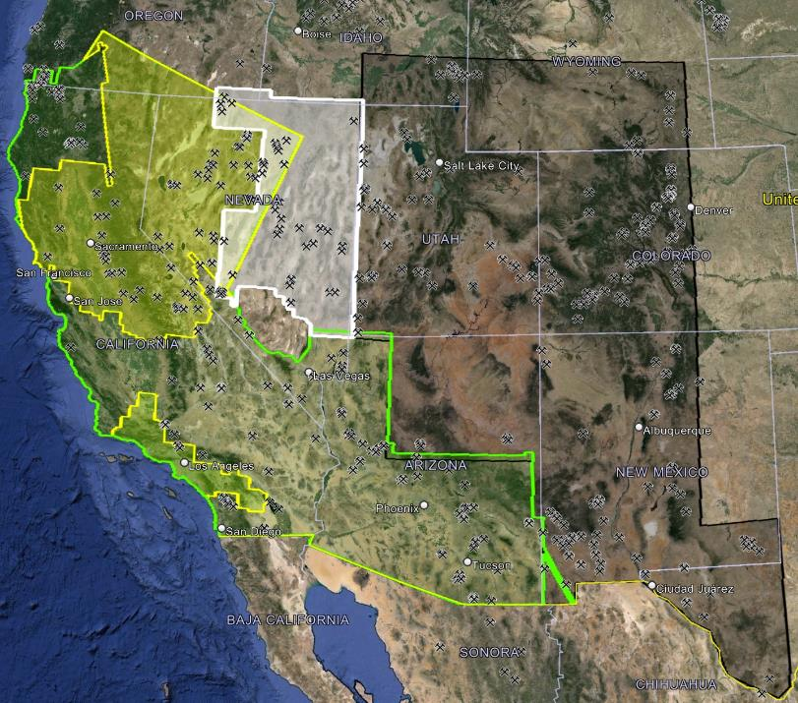
Airborne hyperspectral surveys covering the western U.S.
Regional coverage with multiple sensors over ~500,000 sq km of the arid west
To date the southwestern U.S. has the largest, contiguous terrestrial area of hyperspectral data at such fine spatial resolution (15 m)
Data collection in partnership with NASA at approximately $4M per year
Data will highlight the location and formation of critical minerals related to hydrothermal alteration and rock weathering
Data will also aid mapping of rock-forming minerals to support geologic mapping and mine waste studies
2025
Coverage
2025 & 2026/27
Selected
Coverage
2018
Previously collected NASA hyperspectral data (AVIRIS-Classic). ~325,000 sq. km
2023
2024
USGS Earth MRI 2023-24 AVIRIS-Classic hyperspectral and MASTER thermal infrared multispectral data. ~483,000 sq. km
Preliminary information - subject to revision.

Slide 19
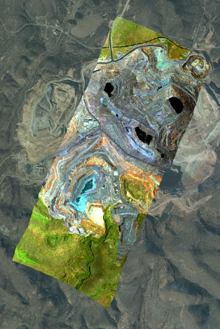
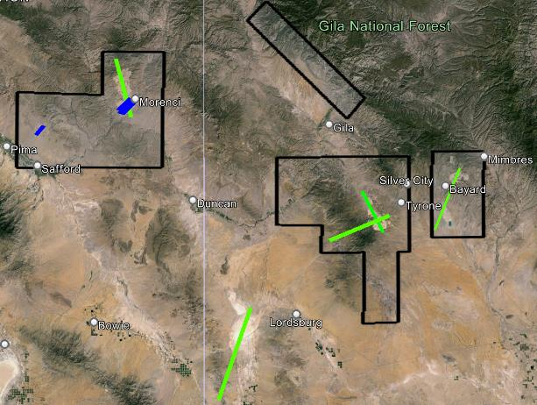
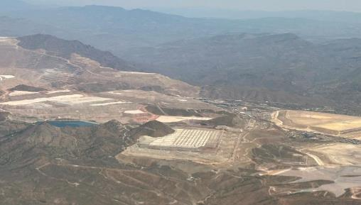
Airborne hyperspectral surveys also target mine waste
In Arizona and New Mexico, multispectral data collection at multiple resolutions/altitudes
Santa Rita
Mine, NM
AVIRIS-3 VSWIR hyperspectral data
collected by NASA on June 15, 2024
AZ
Medium altitude (19.5 kft ASL)
with ~2 m pixel size
Morenci
Mine
NM
Low altitude (9.5 kft ASL)
with ~1 m pixel size
Santa Rita
Mine
Earth MRI contracted
commercial hyperspectral data
VSWIR and TIR
Left: False color-composite from AVIRIS-3 data, Chino Mine, NM.
Below: Photo of Morenci mine, AZ, taken during hyperspectral survey.
Courtesy of Michael Eastwood, Adam Chlus, & the AVIRIS-3 team at the Jet Propulsion Laboratory/NASA
500 m
Additional mine waste areas were covered in AZ by Dean Riley, Univ. of Arizona, leveraging the deployment of the commercial instruments to the region. Dr. Riley is a collaborator on the EMRI hyperspectral acquisitions.
500 m
Morenci Mine, AZ

Slide 20
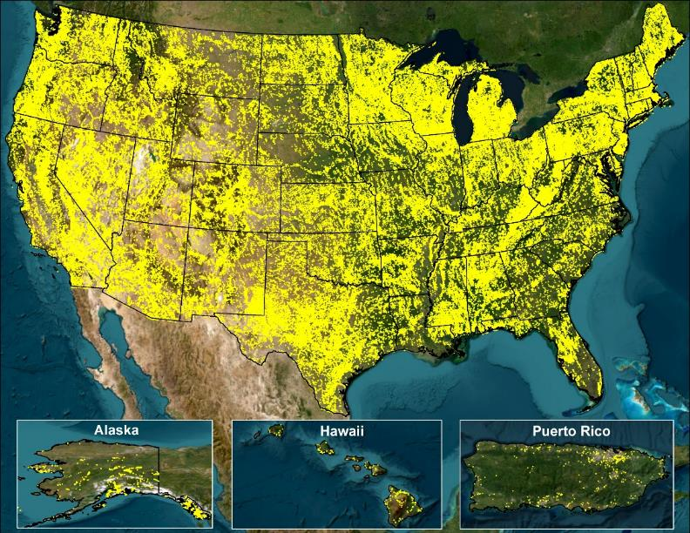
Earth MRI supports mine waste inventory and characterization
USGS has nearly completed the first-ever inventory of legacy mine features across the nation through the USMIN Mineral Deposit Database
Initial inventory of prospect- and mine-related features on USGS topographic maps
Subsequent digitization of large mine waste features (>200,000 sq m) of all mine waste types (~1,551 sites so far in the U.S.)
USGS researchers are working to characterize the critical mineral resource potential of mine waste
Earth MRI funds State geological surveys to contribute to the inventory and characterization through a competitive annual grant program
- 21 states involved so far
Horton, J.D., and San Juan, C.A., 2016, Prospect- and mine-related features from U.S. Geological Survey 7.5- and 15-minute topographic quadrangle maps of the United States (ver. 10.0, May 2023): U.S. Geological Survey data release, https://doi.org/10.5066/F78W3CHG.

Slide 21
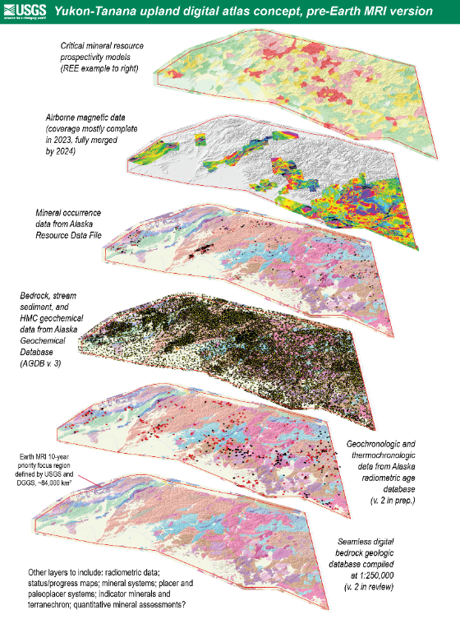
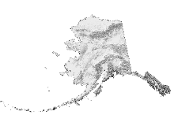
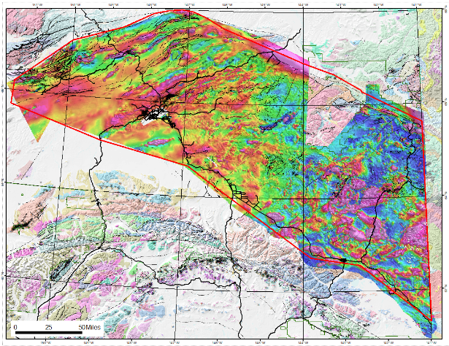
From data collection to delivery, integration, and analysis
We have identified several core requirements for internal use, namely for mineral resource assessments
What do other stakeholder communities want or need?
Visualization?
Data analysis?
Data integration?
Data download?
Map output?
What do other data types or framework applications are of interest?
Murchek, J.T., Drenth, B.J., and Emond, A.M., 2024, Yukon-Tanana Upland airborne magnetic geophysical data merge, version 2023: U.S. Geological Survey data release, https://doi.org/10.5066/P14UWTR3.
Notes:
We think we’ve captured the states that wish to and are able to participate in data collection. But have we captured the full cross-section of potention end users and mapped out where and how the resulting data should be accessed?

Slide 22
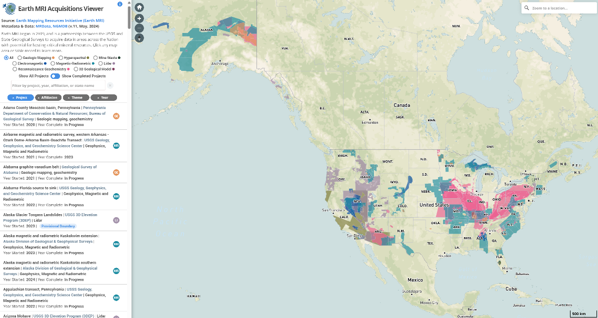
Earth MRI Acquisitions Viewer provides project information
Updated quarterly to include new projects and/or project status updates
Keywords include critical commodities linked to focus area mineral system(s)
Project descriptions link to data and any associated publications
Building new functions into this system based on user feedback
https://ngmdb.usgs.gov/emri
Notes:
We think we’ve captured the states that wish to and are able to participate in data collection. But have we captured the full cross-section of potention end users and mapped out where and how the resulting data should be accessed?

Slide 23
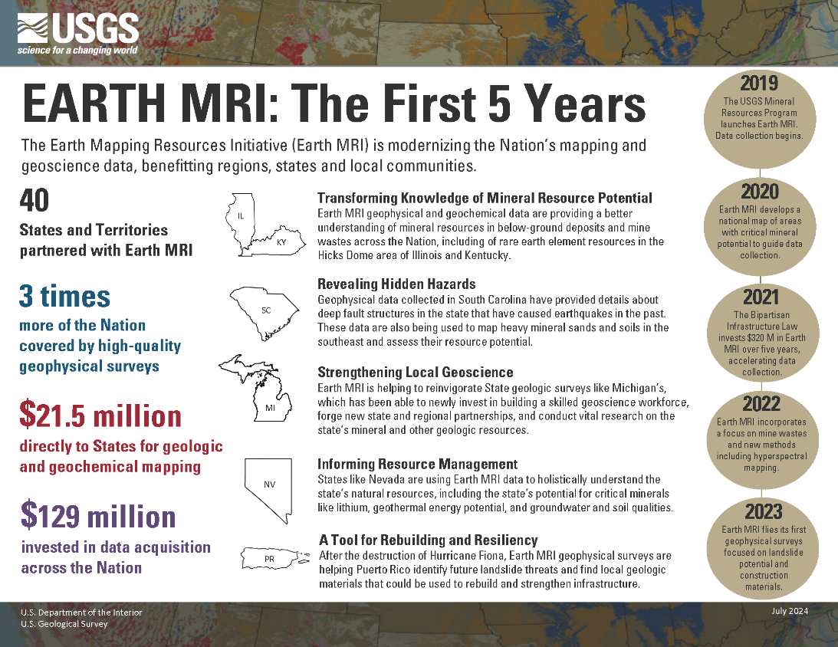
USGS Contacts:
Jamey Jones
Earth MRI Science
Coordinator
jvjones@usgs.gov
Patty Loferski
Earth MRI Deputy
Science Coordinator
ploferski@usgs.gov
Colin Williams
Mineral Resources
Program Coordinator
colin@usgs.gov
Notes:
We think we’ve captured the states that wish to and are able to participate in data collection. But have we captured the full cross-section of potention end users and mapped out where and how the resulting data should be accessed?

Slide 24
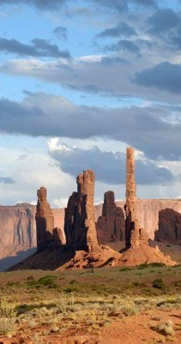
WRP Tribal Engagement Committee Co-Chairs
Will Micklin
  CEO, Ewiiaapaayp Band of Kumeyaay Indians
LeRoy N. Shingoitewa
  Hopi Tribal Council Representative
Floyd W Velasquez Sr.
  Emergency Services Administrator, Morongo Band of Mission Indians

Slide 25
WRP TEC
Next Steps

Slide 26
Roll up of Action Items
Please sign up for a WRP account – wrpinfo.org
  Invite/Encourage other Tribal members/liaisons to be part of TEC
Please provide input on Tribal Leadership Excel document
Seeking Tribal NR Co-Chair and an additional TEC Co-Chair
Interest in being part of a WRP Deep-Dive:
  Water Security/resilience
  Wildland Fire (response/ prevention)
  Aviation/ Airspace Needs
Please indicate if you:
  Are interested in being part of the Outreach Subcommittee
  Have recommendations on future agenda topics
  Have additional resources like a study/funding for the good of the team
Roll up of Action Items

Slide 27
WRP 2025 Calls
April 25 | USGS National Cooperative Geologic Mapping Program (NCGMP) by Kate Ritzel, Physical Scientist, USGS, National Cooperative Geologic Mapping Program CISA Programs and Technical Services for Sovereign Tribes by Jessica Falvey, Program Manager
May 30 | FAA's drone requirements/regulations and how it might impact Tribes/tribal sovereignty by UAS Integration Office and UAS Integration Office New Mexico Energy Conservation and Management (ECAM) Update by Robert Gomez, Sustainability & Resilience Officer
June 27
July 25
August 29
Sept 26 | Vacate/reschedule or keep as scheduled?

Slide 28
Around The Phone

Slide 29
Thank you!

